Slide 1
Hadoop
Majid Salimi
Cloud Computing
September 2018

Slide 2
outline
Basic concepts
  Big Data
  What does MapReduce mean?
  Hadoop
  Virtualization and Cloud
Practical section
  Deploy Hadoop in Cloud environment
GPU accelerated Distributed computing frameworks
  The GPU
  Vispark
  Deep Learning over Big Data Stacks on HPC Clusters
Summary
References

Slide 3

Big Data
Datasets of sizes beyond the capacity of conventional data processing workflow
Ranging from a few terabytes to petabytes
Defined using “3Vs”
  High volume
  High velocity
  High variety
Applications
  Internet
  Media service
  Government
  Science
  Etc.

Slide 4
What is MapReduce?
Proposed by Google
A Big Data processing model
Runs on a large cluster of commodity machines
Map function
  Process input
  Generate intermediate key/value pairs
Reduce function
  Merge all intermediate pairs
Applications:
  Machine Learning
  Document Clustering
  Distributed sorting
  Etc.

Slide 5
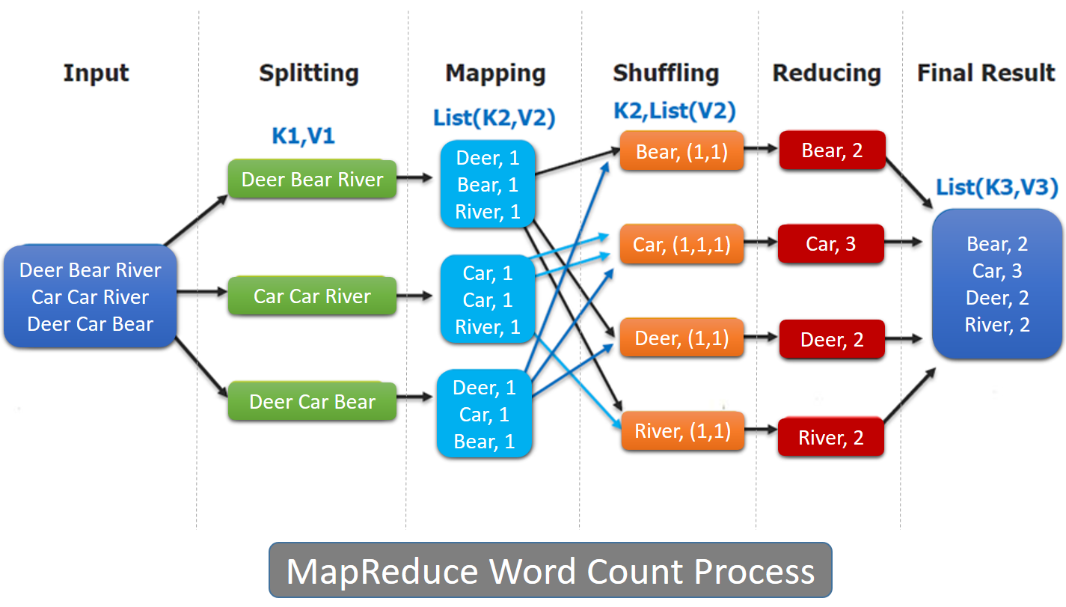
What is MapReduce?(Cont’d)

Slide 6

Hadoop
Open-source implementation of MapReduce
A Programming abstraction
Hadoop runs on clusters and Cloud environments
Can scale up
  Support thousands of hardware nodes
  Massive amounts of data
Hadoop restrictions:
  Too restrictive for certain types of computing tasks
    Dependency between data
  Is not a performance-optimized system
    Slow disk I/O
    Java runtime system

Slide 7
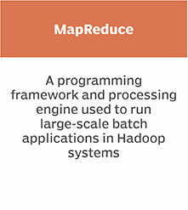
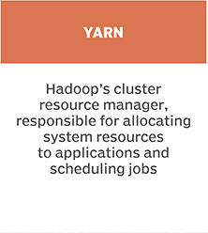
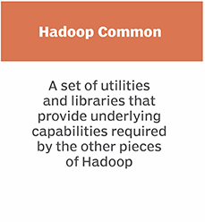
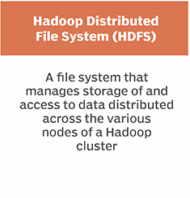
Hadoop’s core components

Slide 8
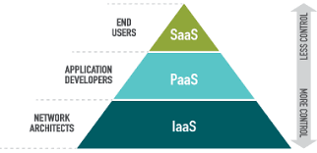

Hadoop and Cloud
Hadoop can work inside a cloud environment
Hadoop in the PaaS
Why Hadoop on the Cloud Makes Sense
  1. Lowering the cost of innovation
  2. Achieve large scale resources quickly
  3. Handling Batch Workloads Efficiently
  4. Handling Variable Resource Requirements
  5. Running Closer to the Data
  6. Simplifying Hadoop Operations

Slide 9

Virtualization and Cloud
Docker is a lightweight virtualization for developers that can be used to build, ship, and run a range of distributed applications
Docker Is Changing The World Of Cloud Computing!
Easy to deploy in the clouds

Slide 10
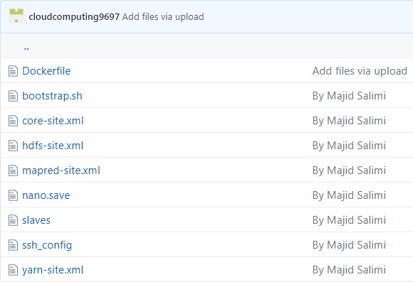
Deploy Hadoop in Cloud environment
Step1: install Docker
Step2: Put the files on GitHub

Slide 11

Deploy Hadoop in Cloud environment
Challenge #1: Docker problem with windows
  Do not use Windows operating system!
  You must reinstall Windows or wait!
  Use Linux

Slide 12
Deploy Hadoop in Cloud environment
Step3: Link Docker to GitHub
Step4: (Swarm) to setup a cluster which has the ability of
  Service discovery
  Load balance
  Retry on failure
  Fast deploy
Step5: Create an overlay network
  Git clone https://www.github.com/cloudcomputing9697/dockerfiles
  docker swarm init --advertise-addr 127.0.0.1
  docker network create --driver overlay swarm-net

Slide 13
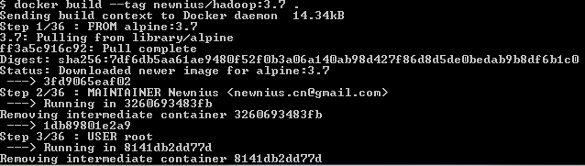
Deploy Hadoop in Cloud environment
Step6: Build docker image
  docker build --tag newnius/hadoop:3.7 .
docker build --tag newnius/hadoop:3.7 .

Slide 14
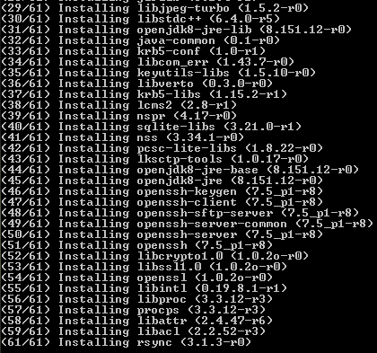
Deploy Hadoop in Cloud environment
Step6: Build docker image
  docker build --tag newnius/hadoop:3.7 .
docker build --tag newnius/hadoop:3.7 .

Slide 15
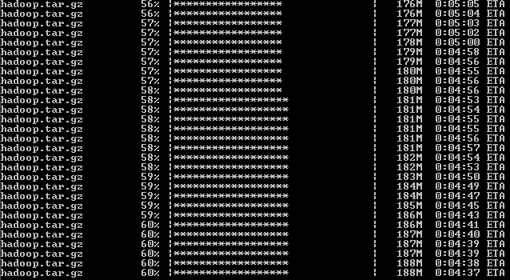
Deploy Hadoop in Cloud environment
Step6: Build docker image
  docker build --tag newnius/hadoop:3.7 .
docker build --tag newnius/hadoop:3.7 .

Slide 16
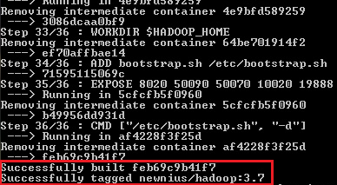
Deploy Hadoop in Cloud environment
Step6: Build docker image
  docker build --tag newnius/hadoop:3.7 .
docker build --tag newnius/hadoop:3.7 .

Slide 17
Deploy Hadoop in Cloud environment
Step7: Start Hadoop Cluster
docker service create \
--name hadoop-master \
--network swarm-net \
--hostname hadoop-master \
--replicas 1 \
--endpoint-mode dnsrr \
newnius/hadoop:3.7
docker service create \
--name hadoop-slave1 \
--network swarm-net \
--hostname hadoop-slave1 \
--replicas 1 \
--endpoint-mode dnsrr \
newnius/hadoop:3.7
docker service create \
--name hadoop-slave2 \
--network swarm-net \
--hostname hadoop-slave2 \
--replicas 1 \
--endpoint-mode dnsrr \
newnius/hadoop:3.7
docker service create \
--name hadoop-slave3 \
--network swarm-net \
--hostname hadoop-slave3 \
--replicas 1 \
--endpoint-mode dnsrr \
newnius/hadoop:3.7

Slide 18

Deploy Hadoop in Cloud environment
Step7: Start Hadoop Cluster

Slide 19
Deploy Hadoop in Cloud environment
Step8: start a proxy to access Hadoop web UI
  To monitor Hadoop yarn
  http://hadoop-master:8088
docker service create \
--replicas 1 \
--name proxy_docker \
--network swarm-net \
-p 7001:7001 \
newnius/docker-proxy

Slide 20
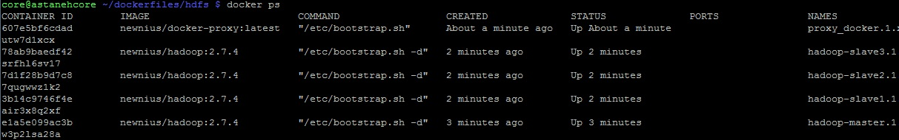
Deploy Hadoop in Cloud environment
Step9:Enter containers
docker exec -it ContainerId bash

Slide 21
Deploy Hadoop in Cloud environment
Step10:format namenode
  In the first time we run Hadoop cluster, it is required to format HDFS in namenode.
# stop all Hadoop processes
sbin/stop-yarn.sh
sbin/stop-dfs.sh
# remove old files of hdfs in host filesystem in all nodes
rm -rf /tmp
# format namenode
bin/hadoop namenode -format
# start yarn and dfs nodes
sbin/start-dfs.sh
sbin/start-yarn.sh

Slide 22
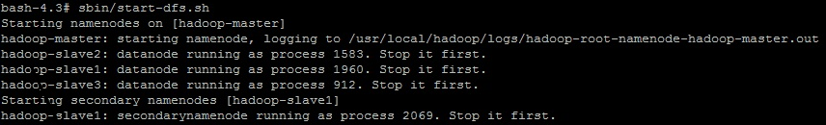
Deploy Hadoop in Cloud environment
Challenge #2:
# stop all Hadoop processes
stop-all.sh
# format namenode
hadoop namenode -format
# start yarn and dfs nodes
start-all.sh

Slide 23
Deploy Hadoop in Cloud environment
Step11:Run a test
  prepare input files to hdfs:///user/root/input
  Run WordCount
bin/hdfs dfs -mkdir -p /user/root/input
bin/hdfs dfs -put etc/hadoop/* /user/root/input
bin/hadoop jar share/hadoop/mapreduce/hadoop-mapreduce-examples-2.7.4.jar wordcount input output

Slide 24
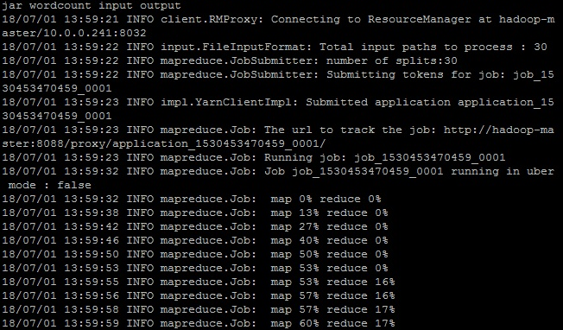
Deploy Hadoop in Cloud environment
Step11:Run a test

Slide 25
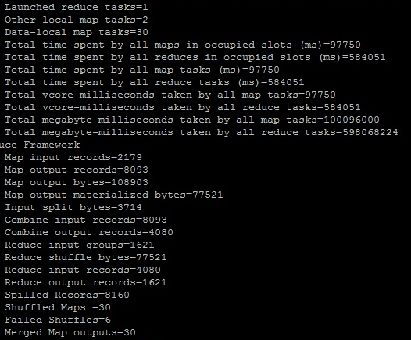
Deploy Hadoop in Cloud environment
Step11:Run a test

Slide 26
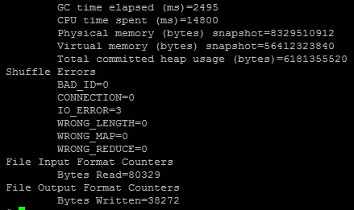
Deploy Hadoop in Cloud environment
Step11:Run a test

Slide 27
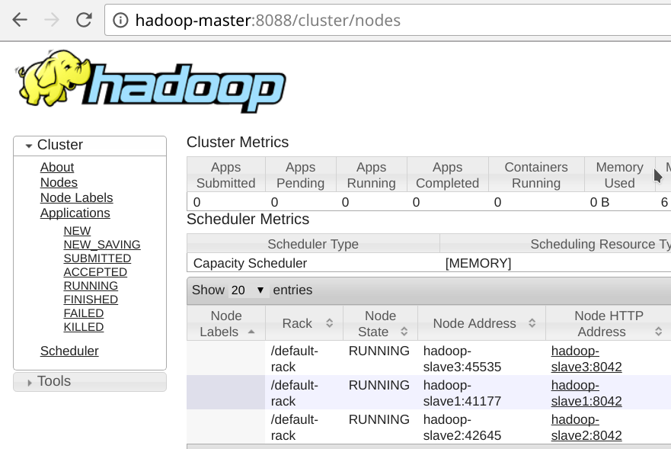
Deploy Hadoop in Cloud environment
Step11:Run a test - Web UI

Slide 28
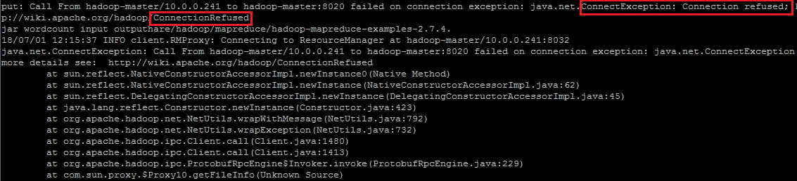
Deploy Hadoop in Cloud environment
Challenge #3: Connection Refused

Slide 29
Deploy Hadoop in Cloud environment
Challenge #3: Connection Refused
Solution:
RUN apk add --no-cache openssh openssl openjdk8-jre rsync bash procps
RUN apk update
RUN apk upgrade
RUN apk add bash
RUN apk add openssh
RUN apk add openssl
RUN apk add openjdk8-jre
RUN apk add rsync
RUN apk add bash
RUN apk add procps

Slide 30
GPU accelerated Distributed computing frameworks
“A recent study shows that the scale-up Hadoop performs better than the scale-out Hadoop”

Slide 31
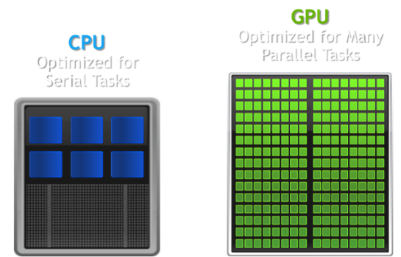
The GPU
Can run a massive number of lightweight threads simultaneously
process data in SIMD
GPU Is a many-core processor with massive thread parallelism
GPU is designed as co-processor
GPU programming is a difficult task
graphics units are the choice for processing big data for scientists and industry

Slide 32
GPU-Accelerated Cloud Computing
Mars
  2008
  Ease the GPU programming effort for MapReduce Apps
  Supports Multi-GPU, integrated architectures and clusters
MapCG
  Single machine MapReduce framework
  Source code portability between CPU and GPU
Grex
  GPU-based MapReduce framework
  Provides new features over Mars and MapCG
  12.4x speedup over Mars
  4.1x speedup over MapCG

Slide 33
GPU-Accelerated Cloud Computing
HadoopCL
  Combination of OpenCL and Hadoop
  Easy-to-learn and flexible API
  Optimized Map-Reduce frameworks for AMD GPUs and Intel Xeon Phi coprocessors
GPMR
  MapReduce library on GPU clusters
  Not based on Hadoop
  Implements the MapReduce Model using MPI
  Supports Multi-GPUs on each node
  Scalability to the number of GPUs is limited

Slide 34
GPU-Accelerated Cloud Computing
(Vispark)
MapReduce for visual computing
  Computer graphics, image processing,…
Consists of two components
  MapReduce programming language
  Distributed runtime system
Python-like language syntax
  Users can easily write programs without any GPU-specific APIs
Vispark runtime system
  Is based on spark
  with novel extensions for automatic task offloading and memory management

Slide 35
GPU-Accelerated Cloud Computing
(Vispark)
Introduces a new data abstraction
  For managing GPU memory
  VRDD
  Stores data with extra information
    Data type, range, partition,…
  Copies the chunk of the data into the GPU and lunches a GPU kernel
  Allows the user to access the data outside the current partition
  The region overlapped with neighbor partition
    Halo
  Computing tasks distributed to different nodes independently

Slide 36
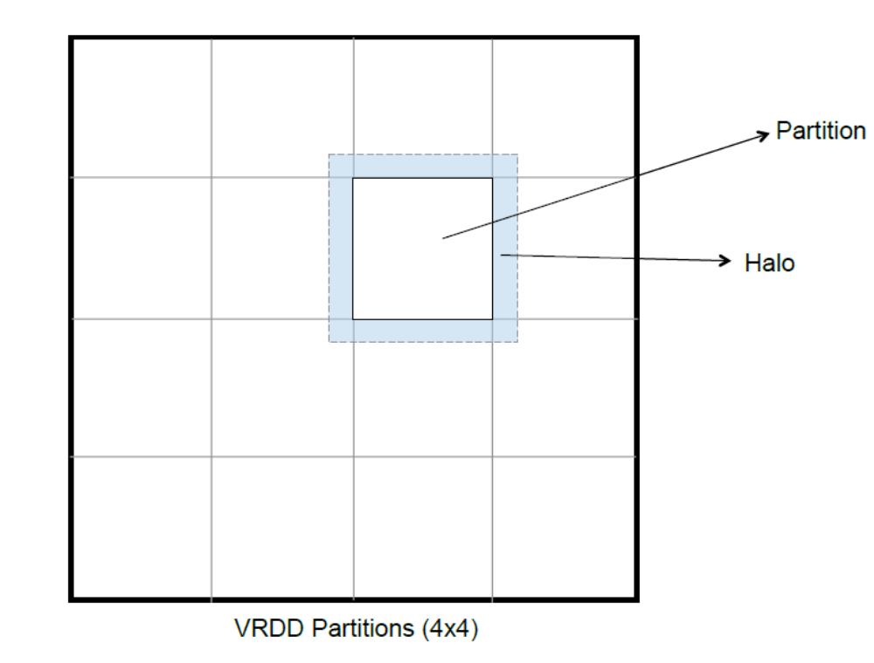
GPU-Accelerated Cloud Computing
(Vispark)
Halo communication
  Automatic halo synchronization
  Transparent to the users

Slide 37
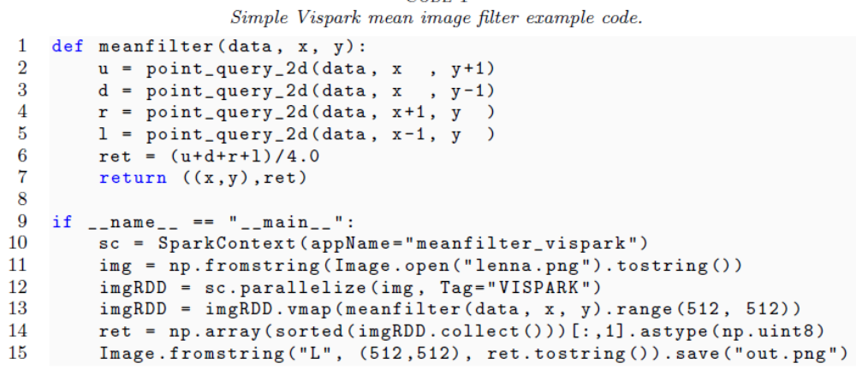
GPU-Accelerated Cloud Computing
(Vispark)
Introduces a new programming abstraction
  For accessing local neighbor data in mapper functions

Slide 38
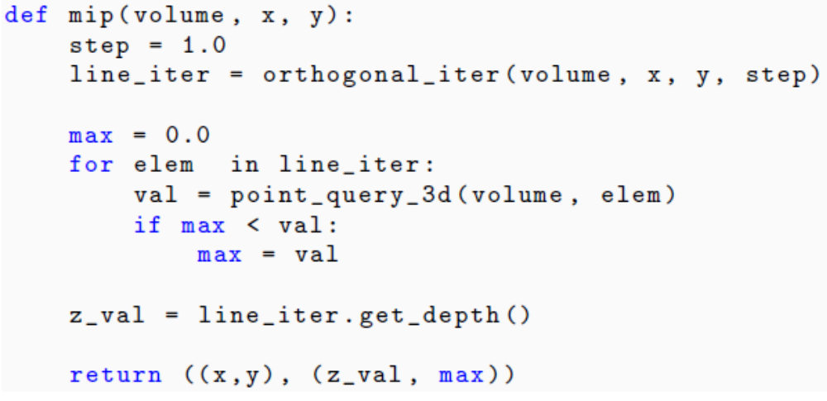
GPU-Accelerated Cloud Computing
(Vispark)
Vispark HDFS data uploader
  Splits the input data into partitions
  Store them in HDFS (with metadata)
Vispark GPU mapper can be implemented
  Compute-intensive visual computing

Slide 39
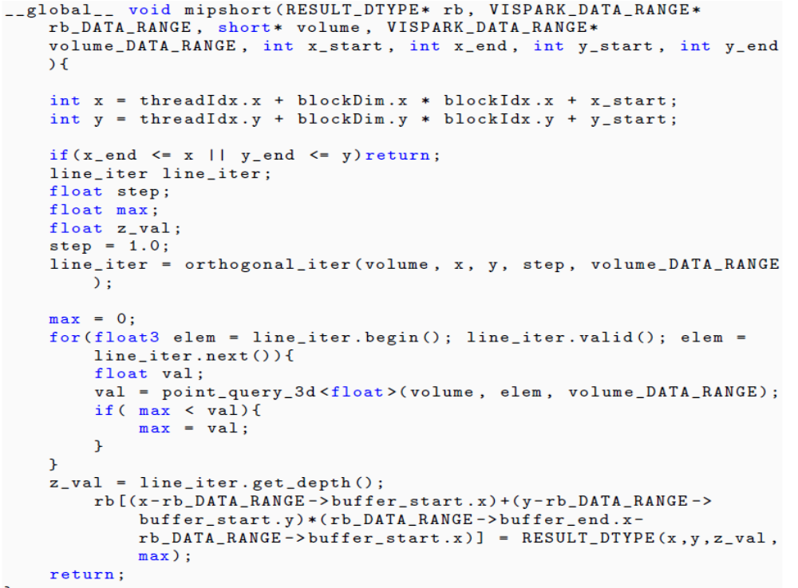
GPU-Accelerated Cloud Computing
(Vispark)
Vispark mapper code is translated to GPU code
  CUDA

Slide 40
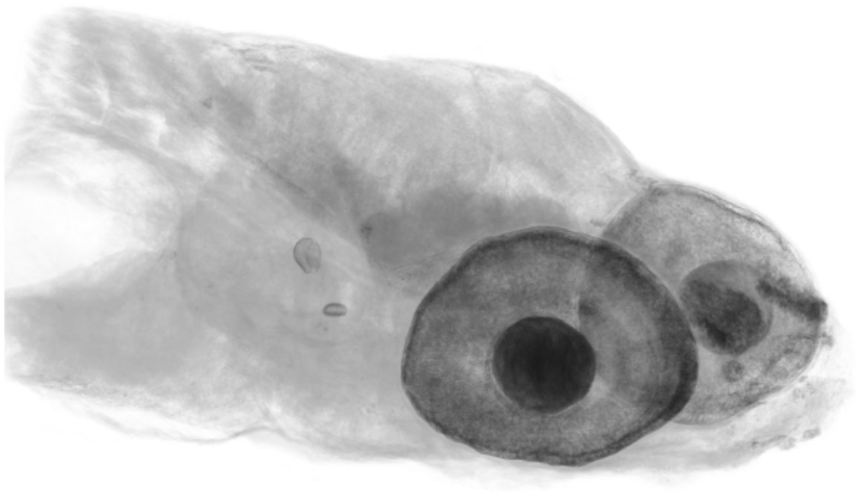
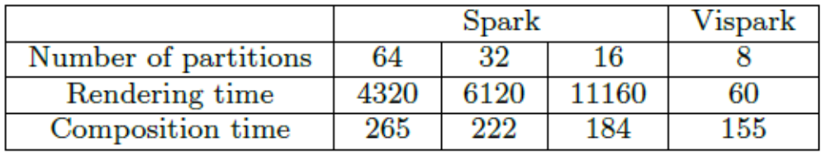
GPU-Accelerated Cloud Computing
(Vispark) - Volume rendering
Zebra fish data set

Slide 41
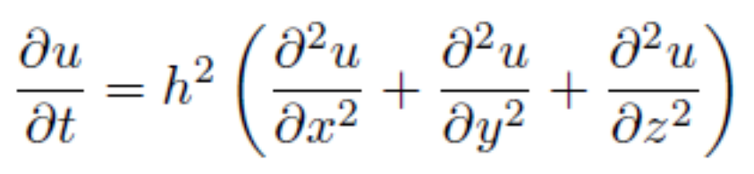
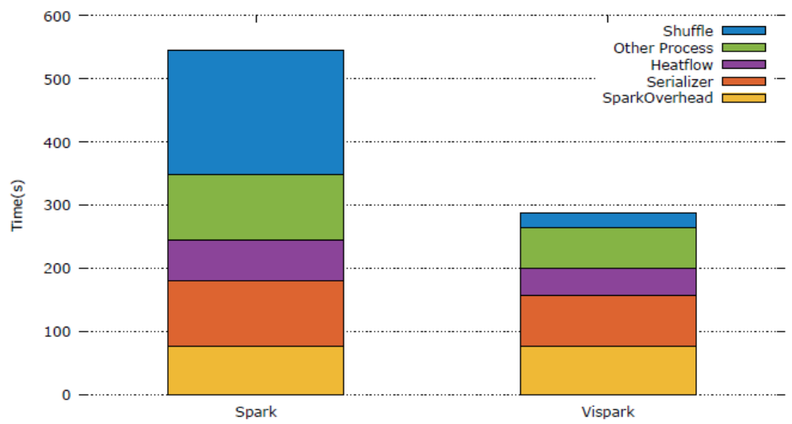
GPU-Accelerated Cloud Computing
(Vispark)- Heat transfer simulation
running time= communication time + computing time + preparation time + serializer time + Spark system overhead

Slide 42
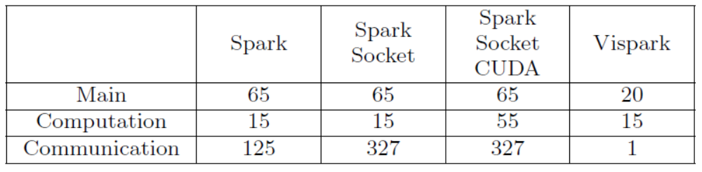
GPU-Accelerated Cloud Computing
(Vispark)- Heat transfer simulation
SLOC comparison of heat transfer simulation in Spark and Vispark

Slide 43
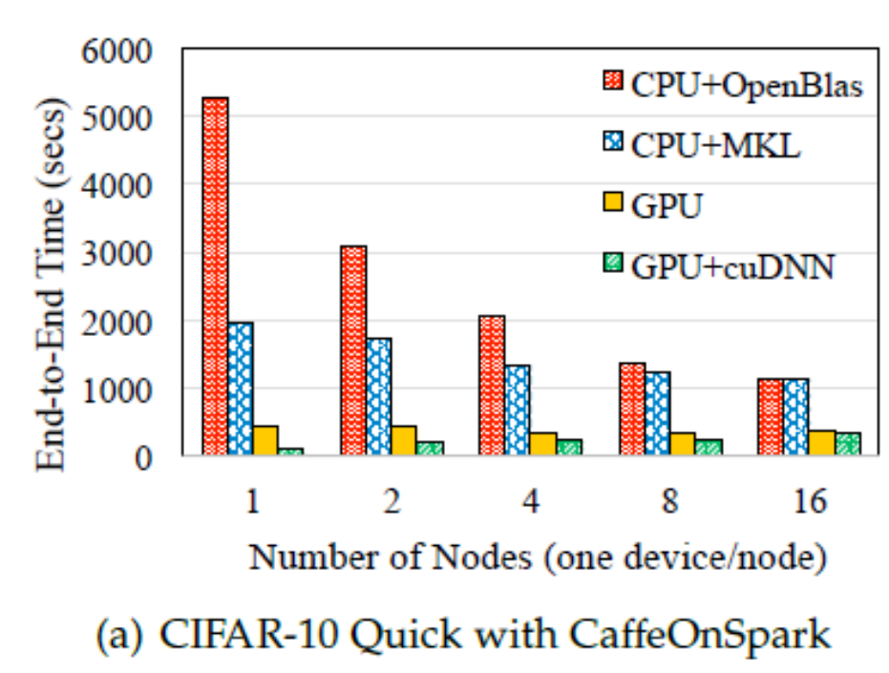
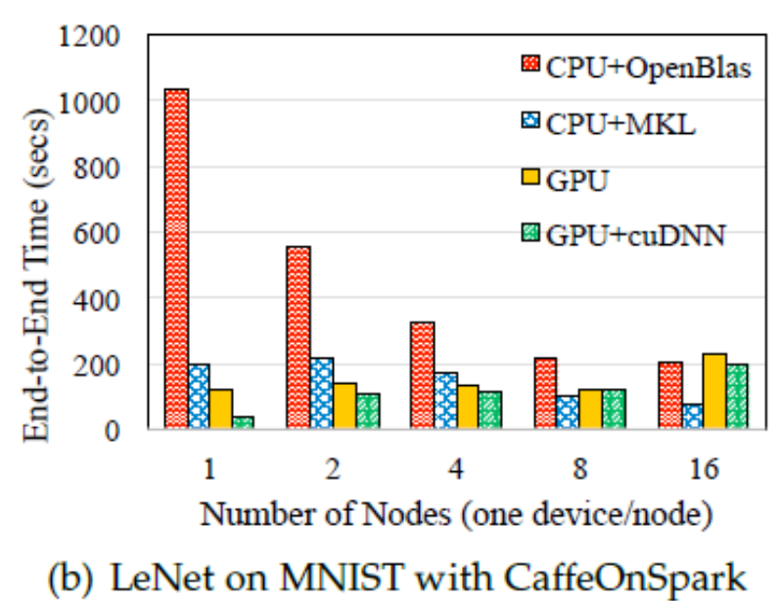
Deep Learning over Big Data Stacks on HPC Clusters
CaffeOnSpark
  Caffe like computing on CPU, GPU, and GPU with accelerating components (e.g., cuDNN)

Slide 44
Summary
MapReduce has become one of the standard computing paradigms for large-scale computing on a cluster system.
The MapReduce model is designed originally for big data processing on large clusters
The speedup on the GPU is very impressive compared to the CPU.

Slide 45
References
https://www.techopedia.com/definition/13816/mapreduce
https://en.wikipedia.org/wiki/MapReduce
https://searchdatamanagement.techtarget.com/definition/Hadoop
https://www.thoughtworks.com/insights/blog/6-reasons-why-hadoop-cloud-makes-sense
https://www.bitcot.com/docker-changing-world-cloud-computing/
https://blog.newnius.com/how-to-quickly-setup-a-hadoop-cluster-in-docker
https://github.com/newnius/Dockerfiles/blob/master/hadoop/2.7.4
Baoxue Zhao, Jianlong Zhong, Bingsheng He, Qiong Luo, Wenbin Fang, and Naga K. Govindaraju. GPU-Accelerated Cloud Computing for Data-Intensive Applications. 2015
WOOHYUK CHOI, SUMIN HONG, AND WON-KI JEONG. VISPARK: GPU-ACCELERATED DISTRIBUTED VISUAL COMPUTING USING SPARK. 2016

Slide 46
Thank You

